Slide 2
Unit Eight

Slide 3
1. Abnormal: not usual, not typical, strange, freakish, unnatural, irregular
Unit 8
Adjective
For my sister, who is always late, being early for an appointment would constitute abnormal behavior.

Slide 4
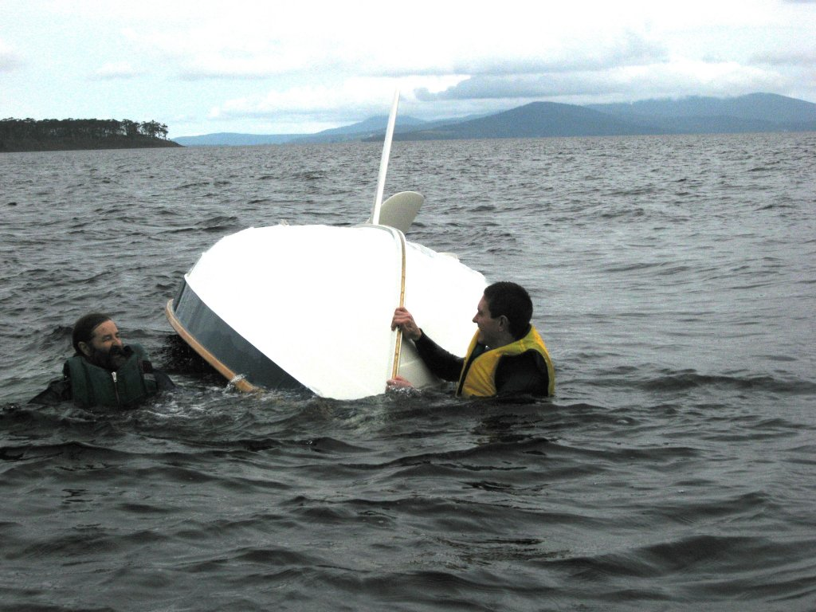
2. Capsize: to turn bottom side up, upset, overturn, upend, tip over
Unit 8
Verb
Anyone watching could see that it was our inexperience that caused us to capsize the boat.

Slide 5
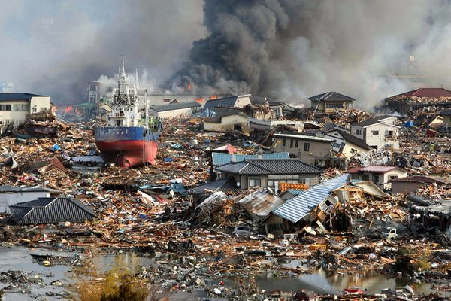
3. Catastrophe: a large-scale disaster, misfortune, or failure, calamity, tragedy, cataclysm
Unit 8
Noun
The March 2011 earthquake and tsunami was a major catastrophe for the people of Japan.

Slide 6
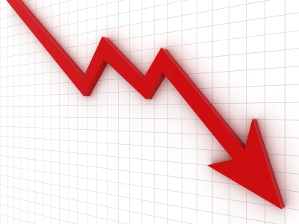
4. Decrease: v. to become or make less, reduce, dwindle, lessen; n. a lessening
Unit 8
Verb
or
Noun
The manager hopes that theft will decrease once the new security system is installed. (v.)
Because of a sharp decrease in sales, the company had to lay off two-thirds of its workers. (n.)

Slide 7
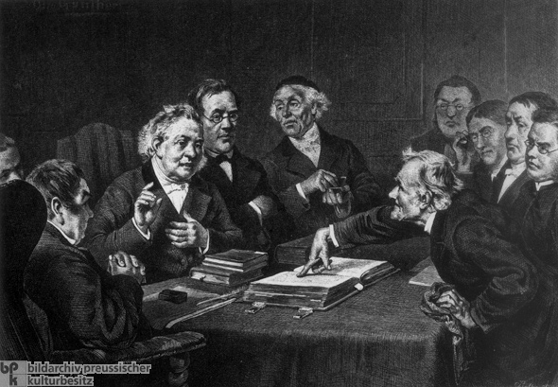
5. Disputatious: inclined to argue or debate; provoking debate; argumentative, quarrelsome, contentious
Unit 8
Adjective
The disputatious senator had engaged in filibusters to block the passage of many a bill.

Slide 8
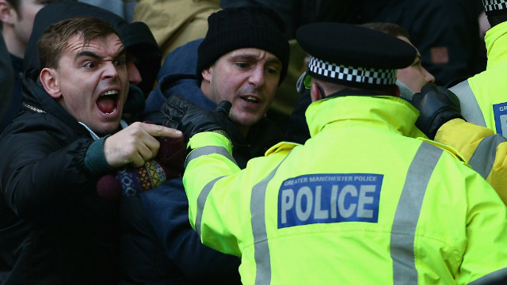
6. Eject: to drive or throw out, evict, oust, expel
Unit 8
Verb
The security guards arrived to eject the troublesome spectator from the stands.

Slide 9
7. Flourish: v. to grow, thrive, be prosperous; to wave in the air; n. a dramatic gesture; a fanfare of horns
Unit 8
Verb
or
Noun
It is fortunate for lovers of the arts that painting and opera still flourish in Italy. (v.)
Actors often enter the stage with a flourish. (n.)

Slide 10
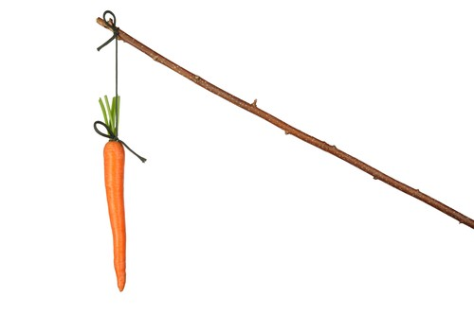
8. Incentive: a reason for doing something; something that stimulates action; a stimulus, inducement
Unit 8
Noun
Because career advancement is such a strong incentive, adults are usually eager and hard-working students.

Slide 11
9. Insubordinate: disobedient, rebellious, defiant, unruly, mutinous
Unit 8
Adjective
The insubordinate student repeatedly interrupted her teachers.

Slide 12
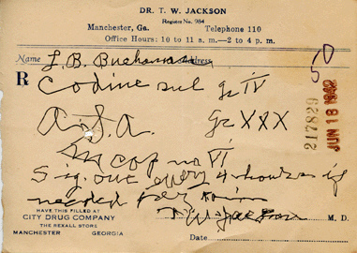
10. Legible: easily read, readable, clear, decipherable
Unit 8
Adjective
In keeping with the jokes, pharmacists will tell you that most doctors’ handwriting is barely legible.

Slide 13
11. Nub: the central point or heart of a matter; a knob, core, kernel, nucleus, crux
Unit 8
Noun
After seemingly endless digressions, the speaker finally got to the nub of his argument.

Slide 14
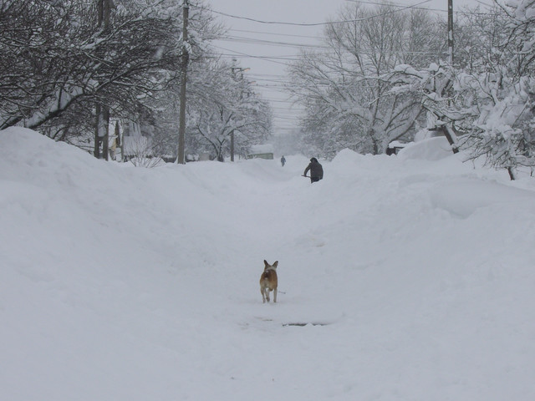
12. Onslaught: a violent attack; a sudden rush of something, assault
Unit 8
Noun
To prepare for the onslaught of winter, we replenished our supply of firewood and rock salt.

Slide 15
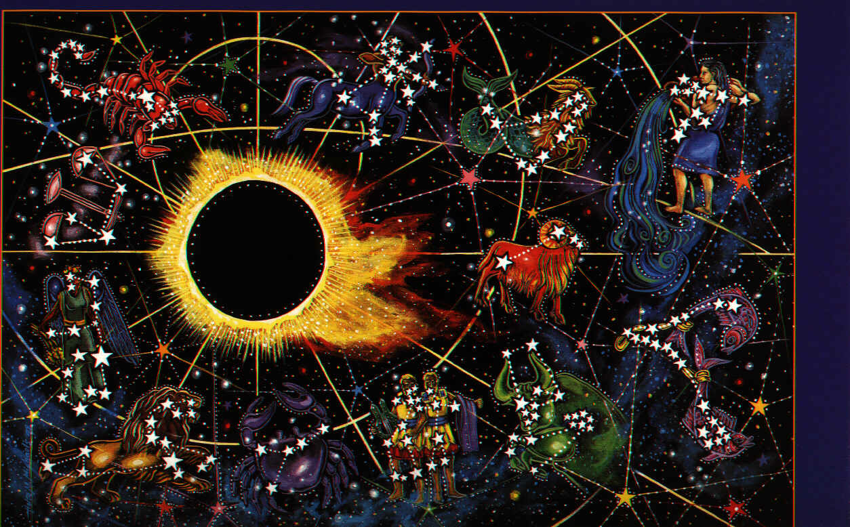
13. Ordain: to establish by law; to order or command; to appoint as a priest or minister; to destine, anoint, consecrate
Unit 8
Verb
Ancient astrologers believed that the stars could ordain one’s future.

Slide 16
14. Outstrip: to get ahead of, do better than, exceed, outdo, outperform, surpass
Unit 8
Verb
By offering customers low prices and good terms, the new store hopes to outstrip the competition.

Slide 17
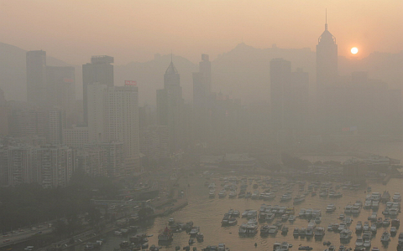
15. Pervade: to spread throughout, saturate, permeate, diffuse, imbue
Unit 8
Verb
Pollutants pervade the atmosphere of many of our nation’s large cities.

Slide 18
16. Prudent: cautious, careful, showing good sense, sensible, wary
Unit 8
Adjective
It pays to make prudent investments.

Slide 19
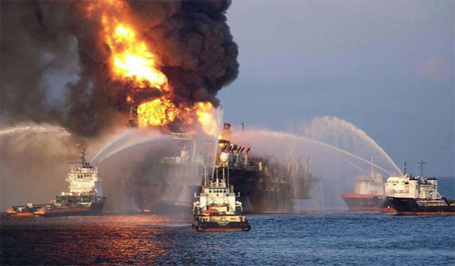
17. Quench: to put out, extinguish, end, douse, stifle
Unit 8
Verb
The firefighters will quench the flames with water.

Slide 20
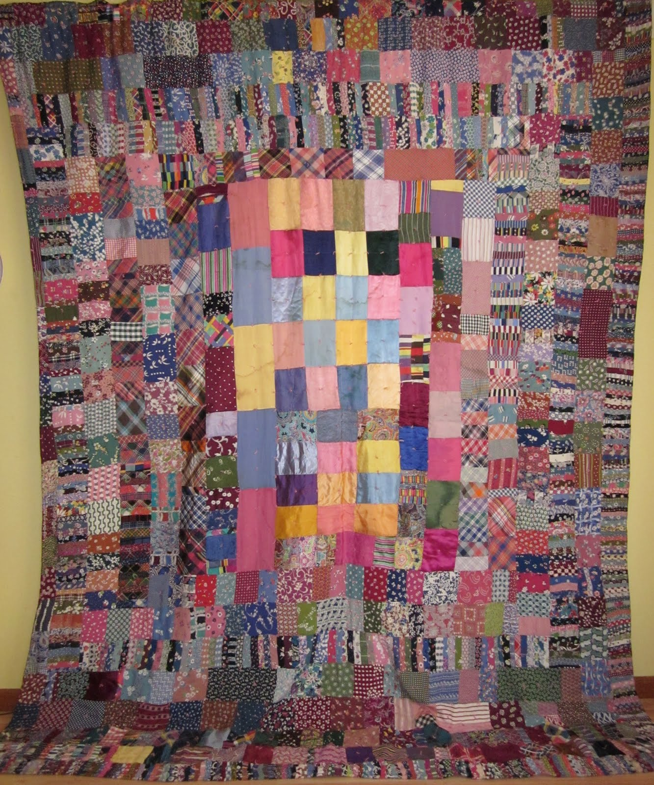
18. Remnant: a small part remaining behind, remainder, residue, leftover, fragment
Unit 8
Noun
Beautiful quilts are often made out of remnants of fabric.

Slide 21
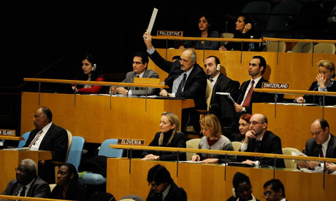
19. Simultaneous: happening or existing at the same time, concurrent
Unit 8
Adjective
The diplomats put on headphones so that they could listen to a simultaneous translation of the speech.

Slide 22
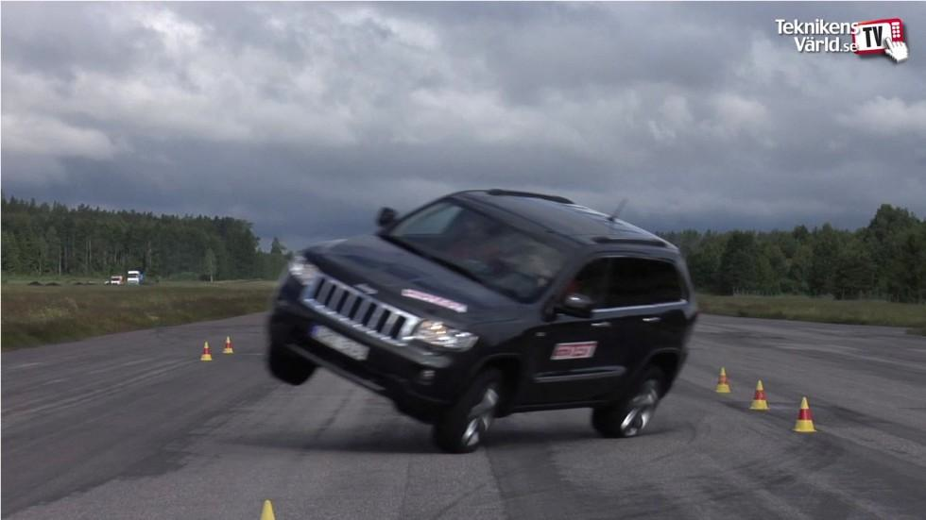
20. Swerve: v. to turn aside sharply, veer; n. a sharp or sudden turn
Unit 8
Verb
or
Noun
Be aware that if you swerve too sharply, you may lose control of the car. (v.)
The sudden swerve of the bus caused some passengers to fall out of their seats. (n.)

